Slide 1
INTRODUCTION

Slide 2

Problem statement
In the college campus, the doctor faces challenges in managing the health records of students and staff. All medical information, such as check-up details, prescriptions, and doctor notes, are maintained manually, leading to data loss, duplication, and difficulty in retrieving past records. The absence of a digital system makes it hard for the campus doctor to efficiently track patient history and provide timely healthcare support.

Slide 3


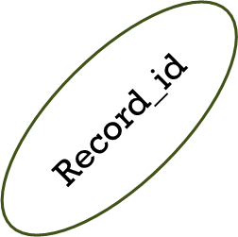
ER-DIAGRAM
USN
name
ISN
year
Name
Branch
Student
Teacher
Dept
1
has
has
ISN
N
Heath record
have
Doctor_note
Date_recorded
USN
Record_id
Conditon details
Patient_type(Student/Teacher
Note_id
Note_text
Time_stamp

Slide 4
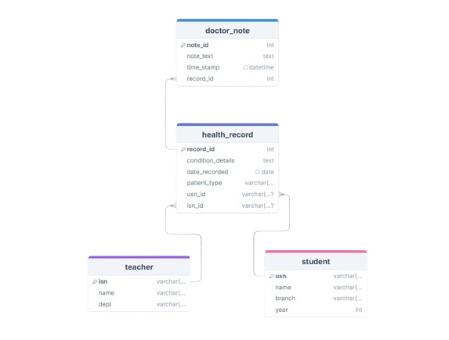
RelationAL DATABASE SCHEME

Slide 5
Campuscare
…..College Health Record management System…..

Slide 6
System Flowchart
Start System
Add Doctor Note
No
Doctor Login
stop
View Combined Details (Patient + Notes + Health)
Yes
Access Doctor Dashboard
Generate Report (Excel / PDF Export)
Connect to Database
END SYSTEM
Add New Patient
Fetch Existing
Add Health Record
Save to Database
Retrieve from DB
Link with Patient ID

Slide 7
Technologies Used in CampusCare
1. Frontend (User Interface Layer)
HTML5 – Defines the structure of web pages.
CSS3 – Styles the pages for a clean and responsive look.
Bootstrap – Makes the dashboard mobile-friendly and visually appealing.
2. Backend (Application Logic Layer)
Python (Django Framework) – Handles server-side logic, routing, and authentication.
Django Views & Templates – Manage data flow between user interface and database.
Django ORM (Object Relational Mapper) – Simplifies database interactions using Python objects.
3. Database (Data Storage Layer)
SQLite Database – Stores student, teacher, health record, and doctor note data.
Django Models – Represent and manage structured data in the database.

Slide 8
PROTOTYPE DEMO

Slide 9
